Slide 1
CHAPTER 5
THE STOCK MARKET

Slide 2
References
HSX trading regulations (https://www.hsc.com.vn/en/help-center/trading-regulations/hose-trading-regulations)
Mishkin & Eakins, Financial Markets + Institutions, 6, Ch10
Madura 9th Chapter 10, Chapter 12

Slide 3
Chapter outline
1. Overview of equity market
2. Some trading regulations in HOSE
3. Margin Trading
4. Market Efficiency

Slide 4
Overview of stock market (self-study)
Stocks: represent ownership of firm’s net assets.
Common stocks versus preferred stocks.
Primary market trading
Public offerings and private placements.
Secondary market trading
Exchanges and over-the-counter markets.
Quote-driven markets and order-driven markets.
(Refer: Madura 9th Chapter 10, Chapter 12)

Slide 5
Trends in Long-Term Financing
Each year, the manager must answer the questions:
Should we finance this year’s long-term projects with debt or equity?
Should we ration our capital and finance only the most attractive projects with this year’s addition to retained earnings?
After the decision is made, the manager must decide the external funds, if any, it will raise this year.
Notes:
Supplement

Slide 6
Trends in Long-Term Financing
Internally generated funds
Short-term and long-term borrowing.
Selling equity
- Staying Private
- Going public

Slide 7
Primary Markets- Issuing Equity
Staying private
Right Offering to Current Shareholders
Private Placement of Equity
Merger or Acquisition
Going public
IPO (Initial Public Offering)
Seasoned Equity Offerings (Right offerings, Public offerings)
Private Placement of Equity
Merger or Acquisition

Slide 8
Private Placement of Equity
A private placement raises funds by allowing outside private investors to purchase shares in the firm.
This may be difficult because new investors may want to examine the original owner’s motives and question their ability.
To limit cost and ensure the compatibility of the new owners, current shareholders may seek possible investors among their friends, relatives, and other contacts.
Another possibility can be to seek financing from venture capitalists, who invest funds in private companies in return for ownership shares.

Slide 9
Merger or Acquisition
Another way to raise money is by selling all or part of the firm to another corporation.
Acquisitions can be negotiated to allow the firm’s managers to retain their current position or to receive lucrative consulting contracts.
Another advantage to a merger or acquisition is when the investor is a large corporation with deep pockets and a willingness to help the firm grow.
The drawback to a merger or acquisition is a loss of control.

Slide 10
Rights offering
Rights offering allows the firm’s current shareholders to purchase additional shares in proportion to their current ownership.
So that the original shareholders remain in control of the firm while raising the needed equity capital.
It was very popular among U.S. public corporations but have become infrequent during the 1980s and 1990s, but remains quite popular in Europe, Asia and Vietnam
Notes:
Phát hành quyền mua cổ phiếu = phát hành thêm cho cổ đông hiện hữu, hấp dẫn nếu giá phát hành thấp hơn giá đang giao dịch trên thị trường, nhưng thực ra giá trị cổ đông không thay đổi. Tuy nhiên, các cty thường đẩy giá cổ phiếu giao dịch để phát hành quyền này thành công hơn.

Slide 11
Rights offering
The advantage of this method is that the current set of shareholders can remain in control.
However, as a group, the shareholders may not be able to raise the needed funds, leading to a failure of the rights offering.

Slide 12
Public offerings
Corporations contract with an investment bank to help them sell securities to the public.

Slide 13
Organized Securities Exchanges
The New York Stock Exchange (NYSE)
Largest stock exchange—over 3,025 companies
Accounts for 90% of stocks traded on exchanges
Specialists make transactions in key stocks
Strictest listing policies
The American Exchange (AMEX)
Second largest stock exchange—about 800 companies and 4% of stocks traded on exchanges
Major market for Exchange Traded Funds
Typically smaller and younger companies who cannot meet stricter listing requirements for NYSE
Hochiminh Stock Exchange (HOSE)
Hanoi Stock Exchange (HNX)

Slide 14
Organized Securities Exchanges (cont’d)
Regional Stock Exchanges
Typically lists between 100–500 companies
Most listed stocks also listed on NYSE or AMEX
Best-known: Chicago, Pacific, Philadelphia, Boston, and Cincinnati
Options Exchanges
Allows trading of options
Best-known: Chicago Board Options Exchange (CBOE)
Futures Exchanges
Allows trading of financial futures (discussed in Chapter 15)
Best-known: Chicago Board of Trade (CBT)

Slide 15
Over-the-Counter (OTC) Market
Nasdaq
Electronic network that connects OTC dealers with buyers and sellers
About 7,000 stocks trade on the Nasdaq
Both IPOs and secondary distributions are sold on OTC
UPCOM
Bid Price: the highest price offered by market maker to purchase a given security
Ask Price: the lowest price at which a market maker is willing to sell a given security

Slide 16
2. Some trading regulations in HOSE
Types of orders
Order matching methods
- Periodic order matching
- Continuous order matching
Ref: http://banggia2.ssi.com.vn/

Slide 17
Limit order
The buy/sell order at a certain price or better.
Buy 1000 shares of DHG at VND109.000 → The investors are willing to buy at VND109.000 or less
Sell 1000 shares of DHG at VND109.000 → The investors are willing to sell at VND109.000 or more
Notes:
Limit order
Maximum price to buy
Minimum price to sell

Slide 18
Order which is executed at the opening order matching price (ATO)
ATO is buy or sell order that is to be matched at the opening price.
ATO orders receive higher priority than limit orders when comparing to match.
ATO orders are entered into the trading system in time for periodic order matching to determine the opening price and will be automatically cancelled at the end of the opening session if they are not executed or partially matched.

Slide 19
Order which is executed at the closing order matching price (ATC)
Similar to the ATO order but applied in time for periodic order matching to determine the closing price.

Slide 20
Market order (MP)
Is a buy/sell order to be executed at lowest offer price/ highest bid price
Once inputting into the trading system, the MP sell order will be immediately executed at the lowest offer price and the MP buy order will be immediately executed at the highest bid price.
In case the MP order is not fully matched, the MP order will be considered as buy order at a higher price or sell order at lower price and continue to match.
The MP order is valid in continuous order-matching session only.
The MP order will be automatically cancelled if there is no corresponding limit order at the time the MP order is input into the trading system

Slide 21
Example of market order (MP)
Stock ABC (Reference price: 14.0; limit up price: 14.7; limit down price 13.3):
MP buy order: 8000 shares
Buying Volume | Price | Selling Volume
5200 | 13.9
8000 | 14.0
 | 14.1 | 6000
 | 14.2 | 3300
 | 14.7 | 2800

Slide 22
Example of market order (MP)
Buying Volume | Price | Selling Volume
5200 | 13.9
8000 | 14.0
 | 14.2 | 1300
 | 14.7 | 2800
Order matching result:
→ Matching price: 14.1; matching volume 6000;
→ Matching price: 14.2; matching volume: 2000
MP sell order: 15000 shares

Slide 23
Example of market order (MP)
Order matching result:
→ Matching price: 14; volume 8000
→ Matching price: 13.9; volume 5200
→ Sell order (price:13.8; volume: 1800)
Buying Volume | Price | Selling Volume
 | 13.8 | 1800
 | 14.2 | 1300
 | 14.7 | 2000

Slide 24
Stop orders
Stop orders are like limit orders because the trade is not executed unless the stock hits a specific price determined by the investor.
A stop-loss order means the stock should be sold if it falls below a price that has been designated by the investor, to prevent greater loss from happening.
Stop-buy orders tell a broker to purchase shares when the price rises above a given limit.
Stop-buy orders are often accompanied by short sales, which are the sales of securities that are borrowed from a broker.

Slide 25
Order matching methods:
Periodic order matching- call markets
Continuous order matching- continuous trading markets

Slide 26
Matching principles
Price Priority:
- Buy orders at higher price will take precedence.
- Sell orders at lower price will take precedence.
Time Priority:
- In case buy or sell orders at the same price, those which entered into the trading system earlier will take precedence in execution.

Slide 27
Periodic order matching- call market
The method is made on the basis of comparing buy orders and sell orders of stocks in a specified time. Principles to determine the price as follows:
- The executed price that reaches largest transaction volume.
- If more than one price satisfies the above condition, the price which is similar or closest with nearest matching order price will be selected.

Slide 28
Example of Call auction
Security P
Buying |  | Price | Selling
Order code | Volume |  | Volume | Order code
M1 | 10.000 | 119 | 10.000 | B1
M2 | 5.500 | 115 | 15.000 | B2, B3
M3 | 7.000 | 114 | 4.000 | B4
M4 | 3.000 | 112 | 3.000 | B5
M5 | 8.500 | 109 | 2.500 | B6
Notes:
Matching price of selling 15000 => 10000/15000*119 + 5000/15000*115 =117
Matching order – sort price orders to identify price priority – selling vlumn and buying vloum
Cơ chế xác định giá phiên mở cửa/đóng cửa: nguyên tắc – giá khớp – tại đó khối lượng giao dịch lớn nhất
Sort giá theo tứ tự cao đến thấp ~ khối lượng mua và bán
Bên mua cộng khối lượng cộng từ trên xuống, bên bán ngược lại

Slide 29
Continuous order matching
The method is made on the basis of comparing buy orders and sell orders immediately when they are inputted into the trading system.

Slide 30
Continuous order matching
Stock V; ceiling price :119 ; reference price: 114, floor price: 109.
9:15 Buy order, price 119; volume 5.000.
9:16 Sell order, price 114, volume 1000
Buying volume | Price | Selling volume
5.000 | 119

Slide 31
Continuous order matching
9:17 sell order, price 117, volume 7000
Buying volume | Price | Selling volume
4.000 | 119
Notes:
Rule = matching price is the price of the previous order
Nếu dư thì đổi thành limit orders

Slide 32
Continuous order matching
9:18 sell order, price 114, volume 3000
Buying volume | Price | Selling volume
 | 117 | 3.000

Slide 33
Continuous order matching
Buying volume | Price | Selling volume
 | 114 | 3.000
 | 117 | 3.000
:
9:20, MP buy order, volume 10.000

Slide 34
Continuous order matching
Buying volume | Price | Selling volume
4.000 | 118

Slide 35
Margin Trading
Using only a portion of the proceeds for an investment
Borrow remaining component
Margin arrangements differ for stocks and futures

Slide 36
Stock Margin Trading
Greatest margin
Currently 30%
Set by the securities companies
Minimum margin
Minimum level the equity margin can be
(called “maintenance” in USA)
Margin call
Call for more equity funds

Slide 37
Margin Trading - Initial Conditions
X Corp $70
50% Initial Margin
30% Minimum Margin
1000 Shares Purchased
Initial Position
Stock $70,000 Borrowed $35,000
Equity $35,000
Notes:
Equity/Total Assets

Slide 38
Margin Trading - Minimum Margin
Stock price falls to $60 per share
New Position
Stock $60,000 Borrowed $35,000
Equity $25,000
Margin% = $25,000/$60,000 = 41.67%

Slide 39
Margin Trading - Margin Call
How far can the stock price fall before a margin call?
Therefore, P = $50
Note: 1,000xP – Amount Borrowed = Equity

Slide 40
Margin Trading
Advantages
Allows use of financial leverage
Magnifies profits
Disadvantages
Magnifies losses
Interest expense on margin loan
Margin calls

Slide 41
Margin Formulas
Basic Margin Formula
Example : buy 100 shares of stock at $40 per share, initial margin requirement is 70%. What happens when stock price moves to $65?

Slide 42
Leveraging effect of margin purchases
You buy 200 shares of XYZ at $100, expecting a 30% appreciation of the stock in one year:
Initial margin: 50%
Financed by a 9% loan for one year
Expected net return: 51%
A 30% drop in the price, though, brings a negative rate of return of -69%.

Slide 43
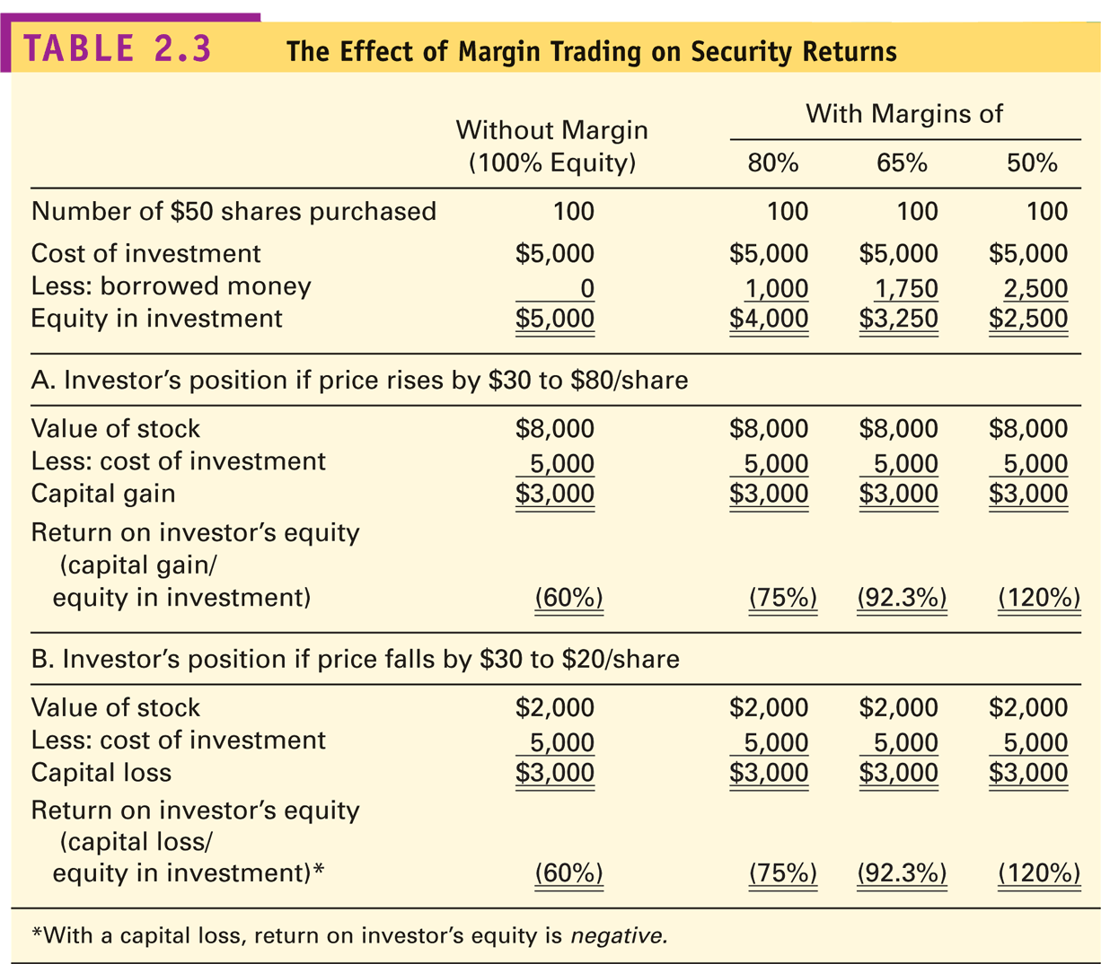
Effect of Margin on Security Returns

Slide 44
Margin Formulas (cont’d)
Return on Invested Capital
Example: buy 100 shares at $50 each, expect the price to rise to $75 in 6 months. Stock pays $2/share annual dividends. You can buy on 50% margin with 10% annual interest rate on the loan. What is the expected return on invested capital?

Slide 45
Leverage ratio
The leverage ratio is the ratio of the value of the position to the value of the equity investment in it.
The leverage ratio indicates how many times larger a position is than the equity that supports to.
Maximum leverage ratio= 1/minimum margin requirement

Slide 46
Problem 1
A buyer buys stock on margin and holds the position for exactly one year, during which time the stock pays a dividend. Assume that the interest on the loan and the dividend are both paid at the end of the year:
Purchase price=$20/share; sale price=$15/share
Shares purchased=1000; leverage ratio=2.5; interest rate=5%; dividend= $0.1/share; commission= $0.01/share
What is the total return on this investment?

Slide 47
Short Sales
Purpose: to profit from a decline in the price of a stock or security
Mechanics
Borrow stock through a broker
Sell it and deposit proceeds and margin in an account
Close out the position: buy the stock and return it to the owner

Slide 48
Short Sale - Initial Conditions
Z Corp 100 Shares
50% Initial Margin
30% Minimum Margin
$100 Initial Price
Sale Proceeds $10,000
Margin & Equity $ 5,000
Stock Owed $10,000

Slide 49
Short Sale - Minimum Margin
Stock Price Rises to $110
Sale Proceeds $10,000
Initial Margin $ 5,000
Stock Owed $11,000
Net Equity $ 4,000
Margin % (4,000/11,000) = 36%

Slide 50
Short Sale - Margin Call
How much can the stock price rise before a margin call?
So, P = $115.38
Note: $15,000 = Initial margin + sale proceeds

Slide 51
Short Selling
Advantages
Chance to profit when stock price declines
Disadvantages
Limited return opportunities: stock price cannot go below $0.00
Unlimited risks: stock price can go up an unlimited amount
If stock price goes up, short seller still needs to buy shares to pay back the “borrowed” shares to the broker
Short sellers may not earn dividends

Slide 52
Problem 2
Sell Short of 100 shares of Smart, Inc., at $50 per share.
Initial margin at 50%
Maintenance margin at 30%
Initially, broker holds a deposit of $7,500 (100 shares sold at $50 per share, plus 50% margin).
What happens if price rise to $70 or falls to $30 subsequently?

Slide 53
Efficient market hypothesis
In this section “efficiency” implies external/ information efficiency.
In an efficient market, securities market prices incorporate all available information. Market prices reflect intrinsic values.
As new information comes randomly, estimates of intrinsic value change, securities prices are not predictable. Investors cannot consistently earn returns higher than the average market return.
(Refer: CFAI 2012 Level 1 Volume 5 SS13, Mishkin & Eakins, Financial Markets + Institutions, Ch.6)

Slide 54
The Efficient Market Hypothesis (EMH)
In an efficient market, prices reflect all available information.
Notice that the level/degree/form of efficiency in a market depends on two dimensions:
1. The type of information incorporated into price
(which information is “available”?).
2. The speed with which new information is incorporated into price ( how fast information is “reflected”?).

Slide 55
Example
Suppose that a share of Microsoft had a closing price yesterday of $90, but new information was announced after the market closed that caused a revision in the forecast of the price for next year to go to $120. If the annual equilibrium return on Microsoft is 15%, what does the efficient market hypothesis indicate the price will go to today when the market opens? (Assume that Microsoft pays no dividends.)

Slide 56
Market reaction to news
Stock Price
Overreaction to “good news” with reversion
Delayed response to “good news”
Efficient market response to “good news”
-30 -20 -10 0 +10 +20 +30
Days before (-) and after (+) announcement

Slide 57
Market reaction to news
Efficient market response to “bad news”
Stock Price
Delayed response to “bad news”
Overreaction to “bad news” with reversion
-30 -20 -10 0 +10 +20 +30
Days before (-) and after (+) announcement

Slide 58
The Different Types of Efficiency
Weak Form
Security prices reflect all information found in past prices and volume.
Semi-Strong Form
Security prices reflect all publicly available information.
Strong Form
Security prices reflect all information—public and private.

Slide 59
Weak Form Market Efficiency
Security prices reflect all information found in past prices and volume.
Often weak-form efficiency is represented as
P_{t} = P_{t-1} + Expected return + random error _{t}
Since stock prices only respond to new information, which by definition arrives randomly, stock prices are said to follow a random walk.

Slide 60
Weak Form Market Efficiency
Price reflects all information contained in market trading data (past prices, volume, dividends, interest rates, etc.).
An investor can not use past prices to identify mispriced securities.
Technical analysis:
→ Refers to the practice of using past patterns in stock prices (and trades) to identify future patterns in prices.
→ Is not profitable in a market which is at least weak form (i.e., weakly) efficient.

Slide 61
Why Technical Analysis Fails
Investor behavior tends to eliminate any profit opportunity associated with stock price patterns.
Stock Price
If it were possible to make big money simply by finding “the pattern” in the stock price movements, everyone would do it and the profits would be competed away.
Sell
Sell
Buy
Buy
Time

Slide 62
Semi-Strong Form Market Efficiency
Security Prices reflect all publicly available information.
Publicly available information includes:
Historical price and volume information
Published accounting statements.
Information found in annual reports.

Slide 63
Semi-Strong Form Market Efficiency “Events” Reflected Immediately
Price reflects all publicly available information.
An investor can not use publicly available information to identify mispriced securities.
Fundamental analysis:
→ Refers to the practice of using financial statements, announcements, and other publicly available information about firms to pick stocks.
→ Is not profitable in a market which is at least semi-strong form (i.e., semi-strongly) efficient.
If a market is semi-strong form efficient, then it is also weak form efficient since past prices and other past trading data are publicly available.

Slide 64
Strong Form Market Efficiency All Private Information is Reflected
Security Prices reflect all information—public and private.
Strong form efficiency incorporates weak and semi-strong form efficiency.
Strong form efficiency says that anything pertinent to the stock and known to at least one investor is already incorporated into the security’s price.

Slide 65
Relationship among Three Different Information Sets
All information relevant to a stock
Information set of publicly available information
Information set of past prices

Slide 66
Why are we Interested in Market Efficiency?
If market prices reflect at a given date only information of a particular type, then one can profit by trading based on information relevant for pricing but not yet reflected in prices.
Anomaly/Abnormal return occurs!

Slide 67
Why are we Interested in Market Efficiency?
To assess the level of market efficiency: need to know the security’s value; which requires knowing how assets are priced.
Joint-Test Problem in Empirical Tests of the EMH: It is always a joint test of market efficiency and the used pricing model.
Notes:
Market Efficiency per se is not testable because
the question whether price reflects a given piece of
information always depends on the model of asset
pricing that the researcher is using. It is always a joint
test of market efficiency and the used pricing model.

Slide 68
Why are we Interested in Market Efficiency?
Despite the joint-test problem, tests of market efficiency, i.e., scientific search for inefficiencies, improves our understanding of the behavior of returns across time and securities. It helps to improve existing asset pricing models and the view and practices of financial-markets professionals.

Slide 69
The Evidence
The record on the EMH is extensive, and in large measure it is reassuring to advocates of the efficiency of markets.
Studies fall into three broad categories:
Are changes in stock prices random? Are there profitable “trading rules”?
Event studies: does the market quickly and accurately respond to new information?
The record of professionally managed investment firms.

Slide 70
Are Changes in Stock Prices Random?
Can we really tell?
Many psychologists and statisticians believe that most people want to see patterns even when faced with pure randomness.
People claiming to see patterns in stock price movements are probably seeing optical illusions.
A matter of degree
Even if we can spot patterns, we need to have returns that beat our transactions costs.
Random stock price changes support weak-form efficiency.

Slide 71
Event Studies: How Tests Are Structured
Event Studies are one type of test of the semi-strong form of market efficiency.
This form of the EMH implies that prices should reflect all publicly available information.
To test this, event studies examine prices and returns over time—particularly around the arrival of new information.
Test for evidence of under reaction, overreaction, early reaction, delayed reaction around the event.

Slide 72
How Tests Are Structured (cont.)
Returns are adjusted to determine if they are abnormal by taking into account what the rest of the market did that day.
The Abnormal Return on a given stock for a particular day can be calculated by subtracting the market’s return on the same day (R_{M}) from the actual return (R) on the stock for that day:
AR= R – R_{M}
The abnormal return can be calculated using the Market Model approach:
AR= R – (α + βR_{M})

Slide 73
Event Studies: Dividend Omissions
Efficient market response to “bad news”
S.H. Szewczyk, G.P. Tsetsekos, and Z. Santout “Do Dividend Omissions Signal Future Earnings or Past Earnings?” Journal of Investing (Spring 1997)

Slide 74
Event Study Results
Over the years, event study methodology has been applied to a large number of events including:
Dividend increases and decreases
Earnings announcements
Mergers
Capital Spending
New Issues of Stock
The studies generally support the view that the market is semistrong-from efficient.
In fact, the studies suggest that markets may even have some foresight into the future—in other words, news tends to leak out in advance of public announcements.

Slide 75
Issues in Examining the Results
Magnitude Issue
Selection Bias Issue
Lucky Event Issue
Possible Model Misspecification

Slide 76
The Record of Mutual Funds
If the market is semistrong-form efficient, then no matter what publicly available information mutual-fund managers rely on to pick stocks, their average returns should be the same as those of the average investor in the market as a whole.
We can test efficiency by comparing the performance of professionally managed mutual funds with the performance of a market index.

Slide 77
The Record of Mutual Funds
Taken from Lubos Pastor and Robert F. Stambaugh, “Evaluating and Investing in Equity Mutual Funds,” unpublished paper, Graduate School of Business, University of Chicago (March 2000).

Slide 78
The Strong Form of the EMH
One group of studies of strong-form market efficiency investigates insider trading.
A number of studies support the view that insider trading is abnormally profitable.
Thus, strong-form efficiency does not seem to be substantiated by the evidence.

Slide 79
Views Contrary to Market Efficiency
Stock Market Crash of 1987
The market dropped between 20 percent and 25 percent on a Monday following a weekend during which little surprising information was released.
Temporal Anomalies
Turn of the year, —month, —week.
Speculative Bubbles
Sometimes a crowd of investors can behave as a single squirrel.

Slide 80
Implications for Corporate Finance
Because information is reflected in security prices quickly, investors should only expect to obtain a normal rate of return.
Awareness of information when it is released does an investor little good. The price adjusts before the investor has time to act on it.
Firms should expect to receive the fair value for securities that they sell.
Fair means that the price they receive for the securities they issue is the present value.
Thus, valuable financing opportunities that arise from fooling investors are unavailable in efficient markets.

Slide 81
Implications for Corporate Finance
The EMH has three implications for corporate finance:
The price of a company’s stock cannot be affected by a change in accounting.
Financial managers cannot “time” issues of stocks and bonds using publicly available information.
A firm can sell as many shares of stocks or bonds as it desires without depressing prices.
There is conflicting empirical evidence on all three points.

Slide 82
Behavioral Finance
The lack of short selling (causing over-priced stocks) may be explained by loss aversion
The large trading volume may be explained by investor overconfidence
Stock market bubbles may be explained by overconfidence and social contagion

Slide 83
End of Chapter 5

